Slide 1


XN PROJECT: MIDTERM PRESENTATION
ALY 6080​ Prof. Atherley Valarie
By
Group 5
Sunil Raj Thota
Sashank Yakkali
Feng Gao

Slide 2
Introduction
Project requirements: using exploratory analysis for analysing the data
Milestones: enabling group to determine which will lead them in the right direction
Job assignments: flexibility and ability to work on all tasks using JIRA and big bucket.
Risks and Strategies: identifying, understanding, communicating, prioritizing and developing
Measure of success: scheduling, cost, quality, stakeholder satisfaction and performance to business case

Slide 3
Executive Summary
GOAL INFOGRAPHICS
The XN project seeks the association between asthma patients and air pollution, and then analyzes to give feasibility recommendations to asthma patients. The Keva Health platform can provide services for medical consultations for asthma patients.
Data collation and analysis
Visual display, feasibility suggestion
Satisfaction survey

Slide 4
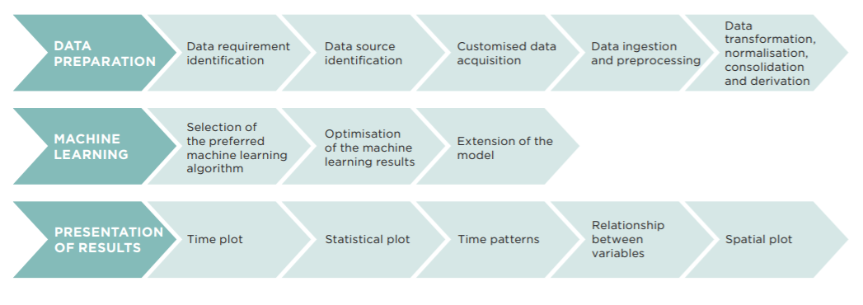
Project Requirements
Here we first gather the data, discover and access, cleanse and validate, transform and enrich data.
Tools used: R/ Python, Tableau/ Power Bi. AWS Quick Sight

Slide 5
Process Roadmap
EDA
Project Scope
Risks and Strategies
Dataset
Job Assignment
Models
Recommendations and Visualizations

Slide 6







Annual Conc. By Monitor 2020
AQS Monitors
Daily AQI By County 2020
Data Exploration
Data Modelling
Data Preprocessing
EPA Gov Data
Data Analysis
Strategic Recommendations
Decision-making

Slide 7
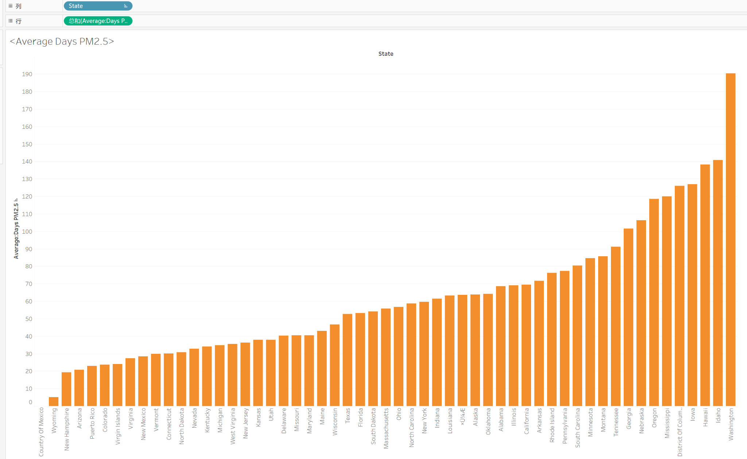
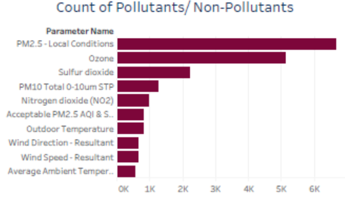
Exploratory Data Analysis
Number of days for PM2.5 from less to more
Count of Pollutants/Non-Pollutants

Slide 8
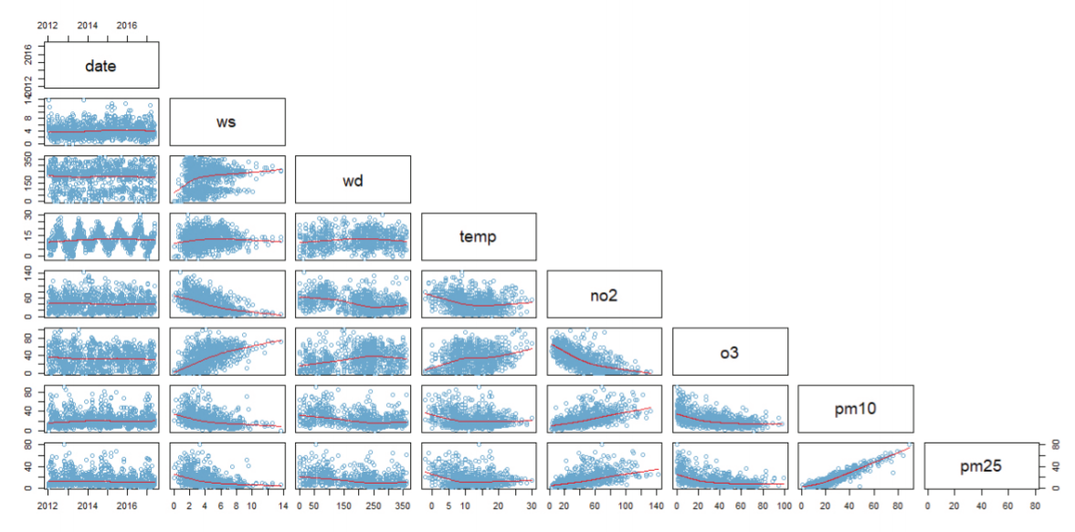
Pair plot of different variables
This describes correlations between different variables of wind speed, wind direction, temperature, NO2, O3, PM10, and PM2.5
shows that concentrations of NO2 generally gradually decrease with the increase of wind speed. Concentrations of NO2 show a slight curve shape with respect to temperature.
This means the concentration first decreases with the increase of temperature above zero degrees Celsius, subsequently increases slightly and stabilizes once the temperature reaches around ten degrees Celsius.

Slide 9
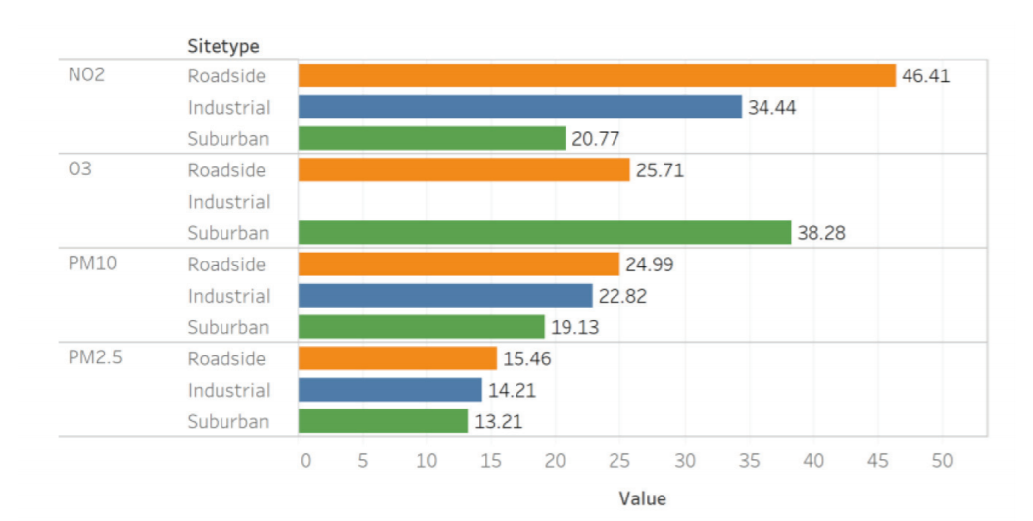
Statistical Plot
Average concentrations of different pollutants of NO2, O3, PM10, and PM2.5 across the roadside sites are ranked highest while those at suburban site are ranked the lowest with those at the industrial site in the middle.

Slide 10
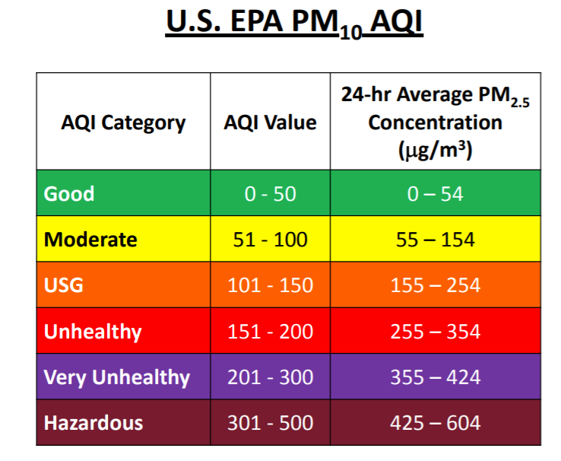
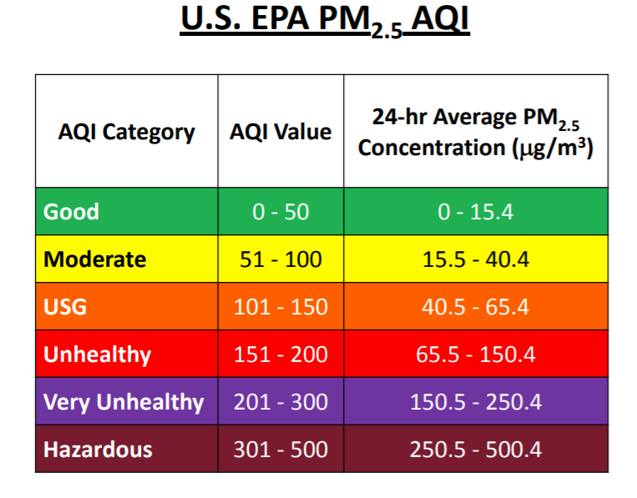
Method of communicating the result
We have categorized the AQI category, AQI value and the 24-Hour PM concentration by dividing it in good (0-50), moderate (51-100), USG (101-150), unhealthy (151-200), very unhealthy (201-300) and hazardous (301- 500), analyzing the basic metrics, and correlation analysis

Slide 11
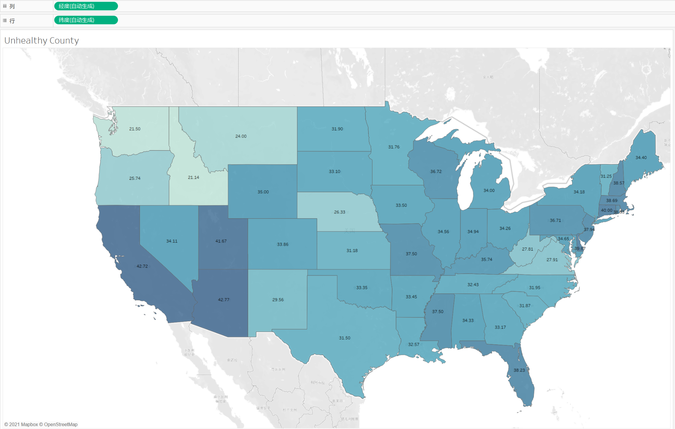
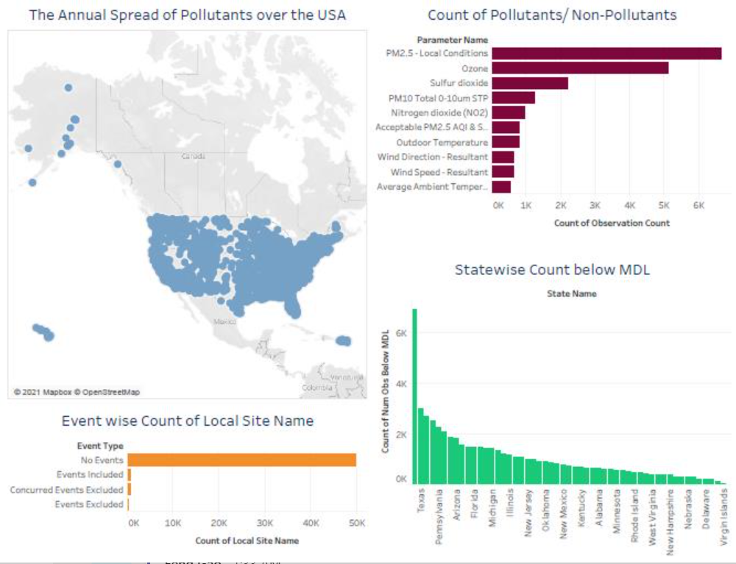
Unhealthy county’s representation
Data
(https://aqs.epa.gov/aqsweb/airdata/download_files.html)
and went ahead to explore this.
We did some basic EDA in R and plotted the visuals in Tableau.
Notes:
We will continue to subdivide all EDA to make the analysis more accurate

Slide 12




Models
Linear
Regression
Random Forest
Lasso Regression
Decision
Tree
Notes:
We are planning use these 4 models and compair which one will be better

Slide 13

Measure Of Success
The concentration area of pollutants basically coincides with the area with high incidence of asthma
Survey satisfaction
User recognition
Sponsor satisfaction
Notes:
Check to see if the project benefited its stakeholders. Inquire of all those involved, including end-users, if the project has benefited the company and its employees.

Slide 14
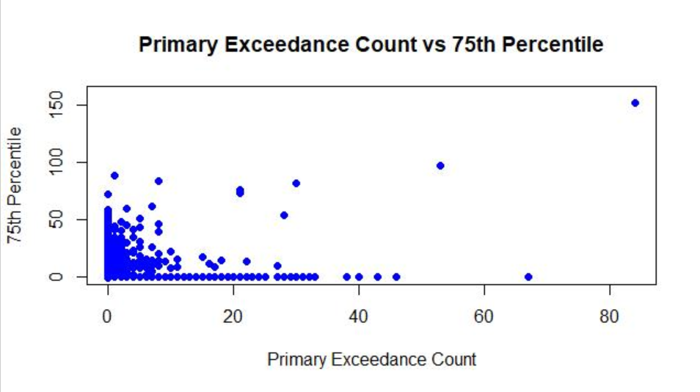
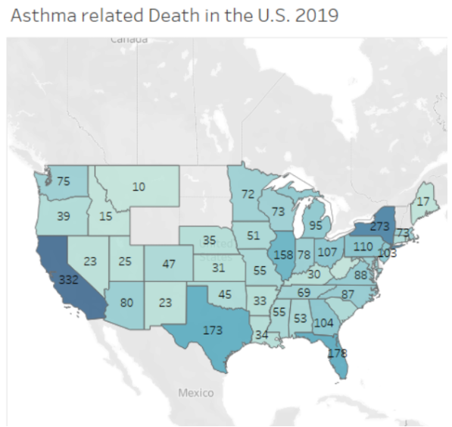
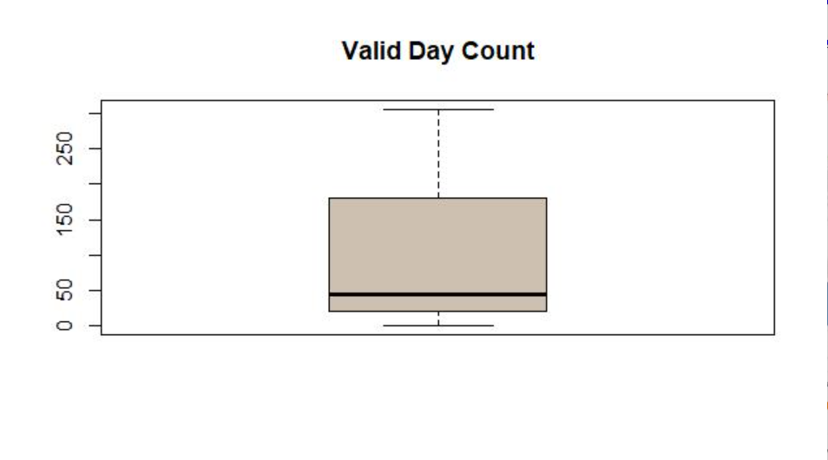
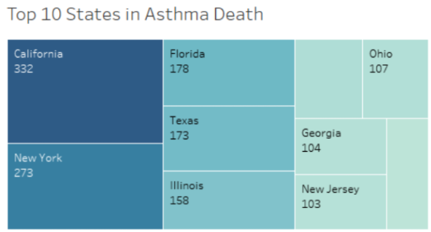
Presentation Method
R/Python Plots
Tableau
Asthma related Death
in U.S 2019
Top 10 States in Asthma Death
Notes:
We create a Dashboard in one of the tools as specified and provide some recommendations to improve Keva Health’s platform by analyzing the data. We may use visual representations to open the eyes of key stakeholders and decision-makers, helping them to understand what a dataset is showing, how a model can help solve a business issue, and what effect the findings can have on the organization easily and rapidly.

Slide 15
Tasks that are to be done
Locating the numerous contaminants are affected by weather variables such as sunlight strength, air temperature, wind speed, wind direction, air pressure, and precipitation.
Finding out how such contaminants, such as nitrogen dioxide and ozone gases, have an inter-relationship such that calculations for these can be used as inputs and outputs.
If there is a hysteresis effect in the atmosphere, where toxins accumulate and dissipate over time.
Examining whether human conditions, such as the days that make up the heart of the working week and the hours of the day when people drive to work, stay at work, and return home after work, influence pollutant levels.

Slide 16
Conclusion
A roadmap helps you and your team get closer to the finish line by visualizing the important components of the project plan.
When we go further into the information, we gain new insights. For nearly 80% of our time, we'll be using EDA to analyse data and solve different business challenges.
We also want to use machine learning algorithms to predict how asthma problems will turn out.
We'll use the Visualization Dashboard to evaluate and present the data in the future.
Look for datasets on emergency room visits that are available to the public and download the air now datasets.
Analyse the impact of air quality on asthma patients by performing an investigation and creating a graphic representation.
Recommendations for using this information to help asthma patients

Slide 17

Thank you

